Slide 1

COMPUTER ORGANIZATION
ADITYA ENGINEERING COLLEGE(A)
By
A. Vanathi
Associate Professor
Dept of Computer Science and Engineering
Aditya Engineering College(A)
Surampalem.

Slide 2
UNIT-IV
Memory Organization: Memory Hierarchy, Main Memory, Auxiliary Memory, Associative Memory, Cache Memory, Virtual Memory.
Input-Output Organization: Peripheral Devices, Input-Output Interface, Asynchronous data transfer, Modes of Transfer, Priority Interrupts, Direct Memory Access.
Aditya Engineering College (A)

Slide 3
Course Objectives:
COB 4: To describe the concepts of Memory System and I/O Organization.
Course Outcomes:
At the end of the Course, Student will be able to:
CO 4: Illustrate the I/O and memory organization in an efficient way.
Aditya Engineering College (A)
COMPUTER ORGANIZATION A. VANATHI, ASSOCIATE PROFESSOR

Slide 4

Chapter 12. Memory Organization
Aditya Engineering College (A)
Memory Hierarchy, Main Memory, Auxiliary Memory, Associative Memory, Cache Memory, Virtual Memory.
Notes:
343

Slide 5
MEMORY ORGANIZATION
Aditya Engineering College (A)
Memory Hierarchy
Main Memory
Auxiliary Memory
Associative Memory
Cache Memory
Virtual Memory
Memory Management Hardware

Slide 6
MEMORY HIERARCHY
Aditya Engineering College (A)
Memory Hierarchy is to obtain the highest possible
access speed while minimizing the total cost of the memory system
Auxiliary memory
Magnetic
tapes
I/O
Main
processor
memory
Magnetic
disks
CPU
Cache
memory
Register
Cache
Main Memory
Magnetic Disk
Magnetic Tape

Slide 7
MAIN MEMORY
Aditya Engineering College (A)
RAM and ROM Chips
Typical RAM chip
Chip select 1
CS1
Chip select 2
CS2
128 x 8
Read
RD
RAM
8-bit data bus
Write
WR
7-bit address
AD 7
CS1 CS2 RD WR
Memory function
State of data bus
0 0 x x
Inhibit
High-impedence
0 1 x x
Inhibit
High-impedence
1 0 0 0
Inhibit
High-impedence
1 0 0 1
Write
Input data to RAM
1 0 1 x
Read
Output data from RAM
1 1 x x
Inhibit
High-impedence
Typical ROM chip
Chip select 1
CS1
Chip select 2
CS2
512 x 8
8-bit data bus
ROM
9-bit address
AD 9

Slide 8
MEMORY ADDRESS MAP
Aditya Engineering College (A)
Address space assignment to each memory chip
Example: 512 bytes RAM and 512 bytes ROM
Hexa
address
Address bus
Component
10 9 8 7 6 5 4 3 2 1
RAM 1
RAM 2
RAM 3
RAM 4
ROM
0000 - 007F
0080 - 00FF
0100 - 017F
0180 - 01FF
0200 - 03FF
0 0 0 x x x x x x x
0 0 1 x x x x x x x
0 1 0 x x x x x x x
0 1 1 x x x x x x x
1 x x x x x x x x x
Memory Connection to CPU
- RAM and ROM chips are connected to a CPU
through the data and address buses
- The low-order lines in the address bus select
the byte within the chips and other lines in the
address bus select a particular chip through
its chip select inputs

Slide 9

CONNECTION OF MEMORY TO CPU
Aditya Engineering College (A)
Address bus
CPU
16-11
10
9
8
7-1
RD
WR
Data bus
Decoder
3
2
1
0
CS1
CS2
128 x 8
Data
RD
RAM 1
WR
AD7
CS1
CS2
128 x 8
Data
RD
RAM 2
WR
AD7
CS1
CS2
128 x 8
Data
RD
RAM 3
WR
AD7
CS1
CS2
128 x 8
Data
RD
RAM 4
WR
AD7
CS1
1- 7
CS2
512 x 8
Data
8
AD9
ROM
9

Slide 10
Associative Memory
Aditya Engineering College (A)
The time required to find an item stored in memory can be reduced considerably if stored data can be identified for access by the content of the data itself rather than by an address. A memory unit accessed by content is called an associative memory or content addressable memory (CAM).
the associative memory is uniquely suited to do parallel searches by data association.

Slide 11
Associative Memory
Aditya Engineering College (A)
Advantages of associative memory
Associative memory searching process is fast.
Associative memory is suitable for parallel searches.
Disadvantages of associative memory
:
Associative memory is expensive than RAM
The associative memory hardware structure consists of:
memory array, logic for m words with n bits per word, and
several registers like input register, mask register, select register and output register.
It consists of a memory array and logic for m words with n bits per word. The argument register A and key register K each have n bits, one for each bit of a word. The match register M has m bits, one for each memory word. Each word in memory is compared in parallel with the content of the argument register

Slide 12
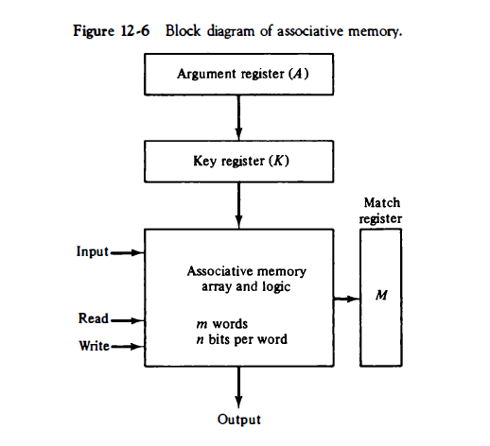
Block Diagram of Associative Memory
Aditya Engineering College (A)
COMPUTER ORGANIZATION A. VANATHI

Slide 13
Aditya Engineering College (A)
A 101 1 1 1 100
K 111 000000
Word 1 100 1 1 1 100 no match
Word 2 101 000001 match
COMPUTER ORGANIZATION A. VANATHI

Slide 14
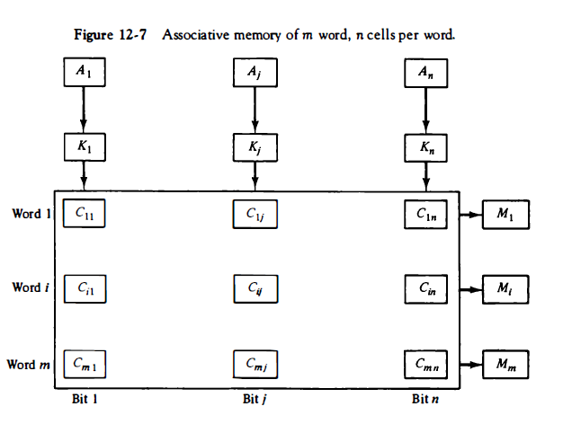
Aditya Engineering College (A)
COMPUTER ORGANIZATION A. VANATHI

Slide 15
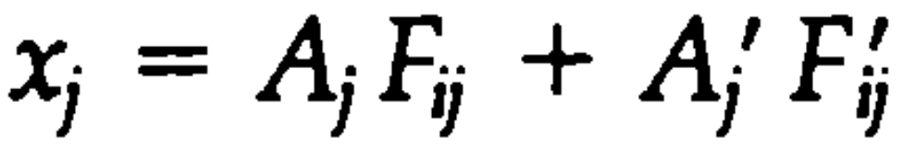

Aditya Engineering College (A)
Match Logic
The match logic for each word can be derived from the comparison algorithm for two binary numbers.
Two bits are equal if they are both 1 or both 0. The equality of two bits can be expressed logically by the Boolean function
where xi = 1 if the pair of bits in position j are equal; otherwise, xi = 0.
For a word i to be equal to the argument in A we must have all xi variables equal to 1. This is the condition for setting the corresponding match bit M, to 1. The Boolean function for this condition is
COMPUTER ORGANIZATION A. VANATHI, ASSOCIATE PROFESSOR

Slide 16
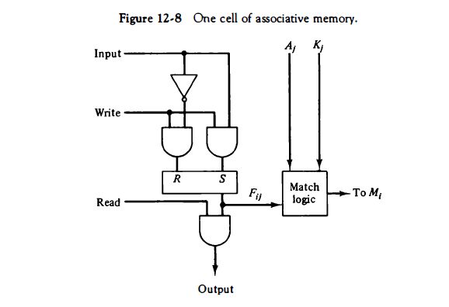
Aditya Engineering College (A)
COMPUTER ORGANIZATION A. VANATHI

Slide 17
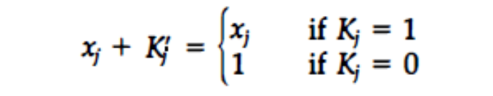
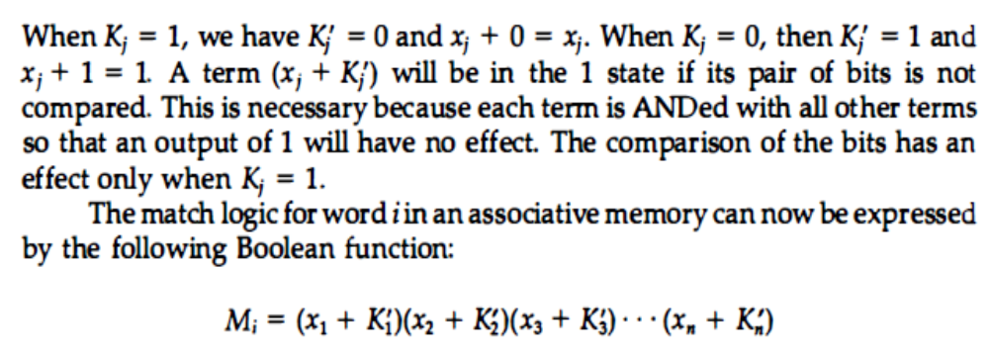
Aditya Engineering College (A)
We now include the key bit K; in the comparison logic. The requirement is that if
K = 0, the corresponding bits of A; and f1; need no comparison. Only when K = 1 must they be compared. This requirement is achieved by Oring each term with Kj, thus:
COMPUTER ORGANIZATION A. VANATHI,

Slide 18
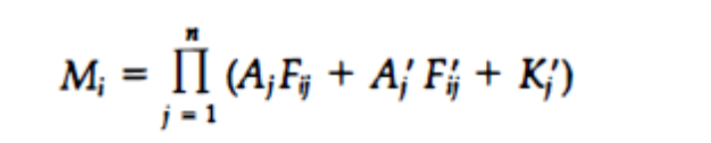
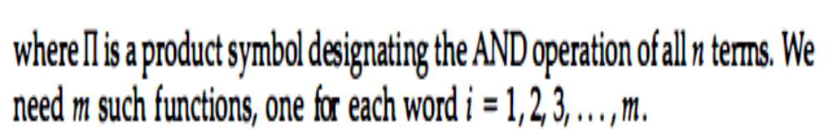
Aditya Engineering College (A)
If we substitute the xj value then we will get the final equation as,
COMPUTER ORGANIZATION A. VANATHI

Slide 19
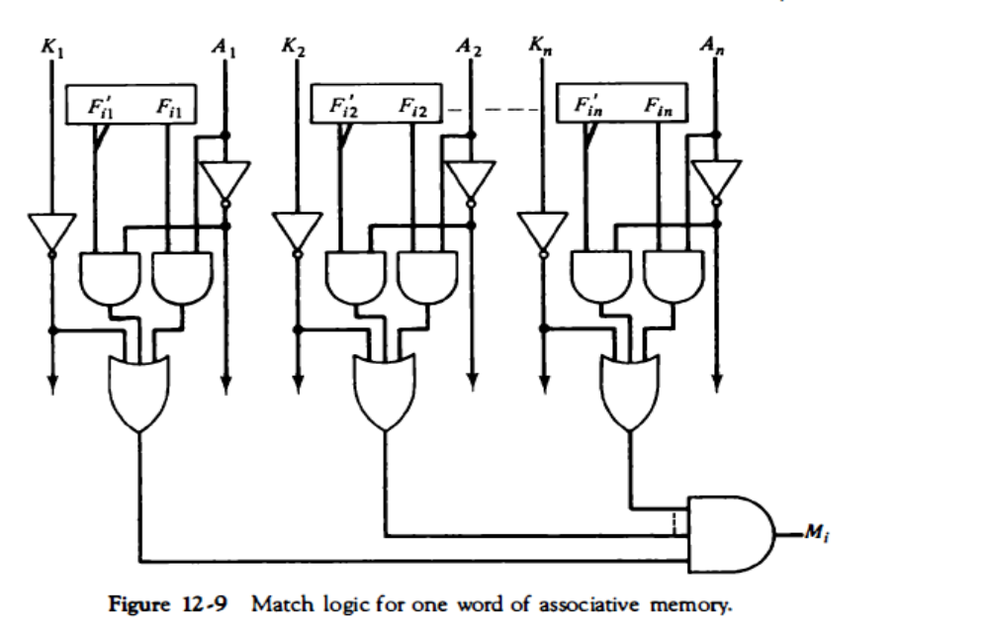
Aditya Engineering College (A)
COMPUTER ORGANIZATION A. VANATHI

Slide 20
Aditya Engineering College (A)
Read Operation
If more than one word in memory matches the unmasked argument field, all the matched words will have 1's in the corresponding bit position of the match register. It is then necessary to scan the bits of the match register one at a time.
The matched words are read in sequence by applying a read signal to each word line whose corresponding M, bit is a 1 .
In most applications, the associative memory stores a table with no two identical items 'under a given key.
In this case, only one word may match the unmasked argument field. By connecting output M; directly to the read line in the same word position (instead of the M register), the content of the matched word will be presented automatically at the output lines and no special read command signal is needed.
COMPUTER ORGANIZATION A. VANATHI

Slide 21
Aditya Engineering College (A)
Write Operation
Writing in an associative memory can take different forms, depending on the application.
Initially all data were written in the memory in a sequence
This will make the device a random access memory for writing and a content addressable memory for reading.
If unwanted words have to be deleted and new words inserted one at a time, there is a need for a special register to distinguish between active and inactive words. This register, sometimes called a tag register, would have as many bits as there are words in the memory.
For every active word stored in memory, the corresponding bit in the tag register is set to 1. A word is deleted from memory by clearing its tag bit to 0.
Words are stored in memory by scanning the tag register until the first 0 bit is encountered. This gives the first available inactive word and a position for writing a new word. After the new word is stored in memory it is made active by setting its tag bit to 1 . An unwanted word when deleted from memory can be cleared to all 0' s if this value is used to specify an empty location. Moreover, the words that have a tag bit of 0 must be masked (together with the Ki bits) with the argument word so that only active words are compared.
COMPUTER ORGANIZATION A. VANATHI

